Slide 1


Seth Rose, Nicholas Wenzel
Poor Artist Games

Slide 2
Concept
Turn based RPG with a sci-fi setting
Built on GML and GameMaker Studio 2
Players can navigate the world with dialogue and take different approaches to each situation
Top down world navigation
Side view combat scenes
Portrait with dialogue options

Slide 3
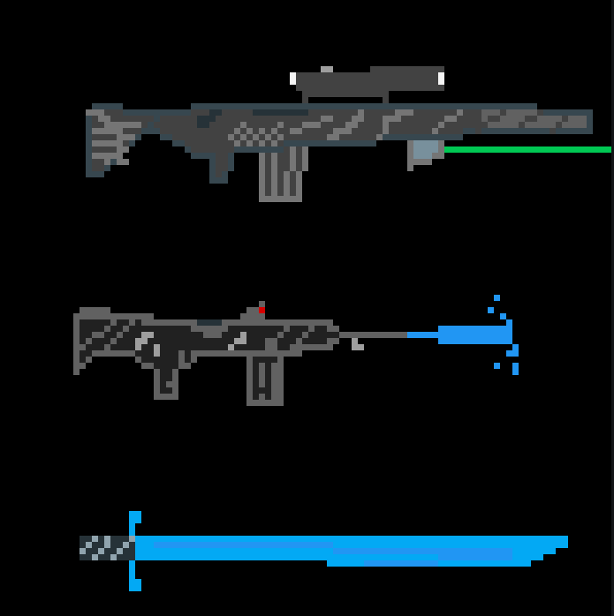
Combat
Turn based against AI
Turn order based on speed stat of character
Control a party of characters that fight enemies
Party members have advantages in specific stats
Success in combat is dependent on stats and some chance calculations
Difficulty of combat scales with the type of enemies and the stats that the enemies have

Slide 4
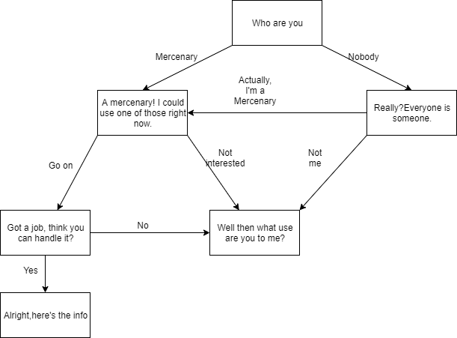
Conversation
Impacts story
Choice/illusion of choice
Characters remember interactions
Factions

Slide 5
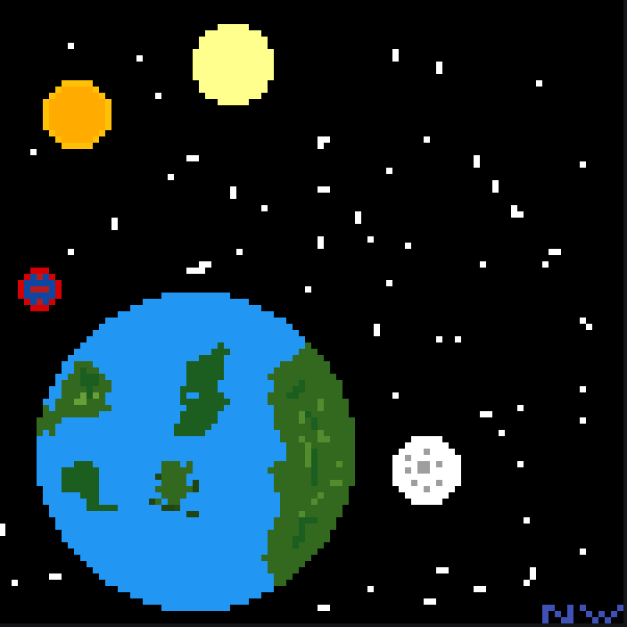
Setting
Ship: SSV Icarus
Small freelance cargo frigate
Bad Guys:Opposing faction
Blue Suns
Red Moons
Good Guys: Freelance Mercenaries
Main Character: Human
Elysian Sniper
Android Melee Fighter
Planet: Helios V
Earth like planet
Outer planet no central authority
Small colony

Slide 6
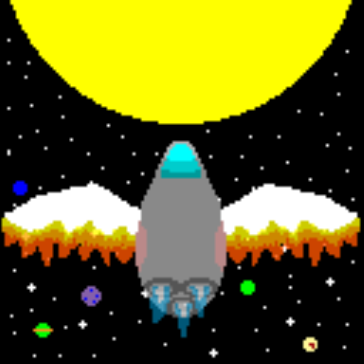
Narrative
Crew is on a job to Helios when their ship breaks
Now they are trying to fix their ship and close the job while dealing with the 2 factions

Slide 7

Art
2D Top Down sprites. Low definition in overworld higher in fights/ talking to characters
Walking animations
Attack animations
Follows a bright, retro art style that uses a lot of bright colors and contrast
Characters and locations grounded in reality but strange enough to be interesting

Slide 8
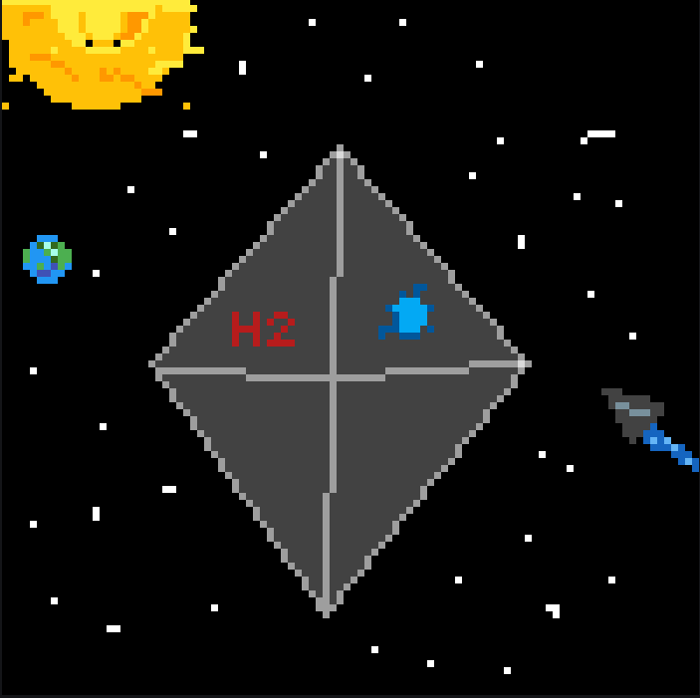

Music and Sounds
Ambient Sci-Fi music
No Man’s Sky
Mass Effect
Classic Sci-Fi noises
Star Wars
Blaster:
Teleport:

Slide 9
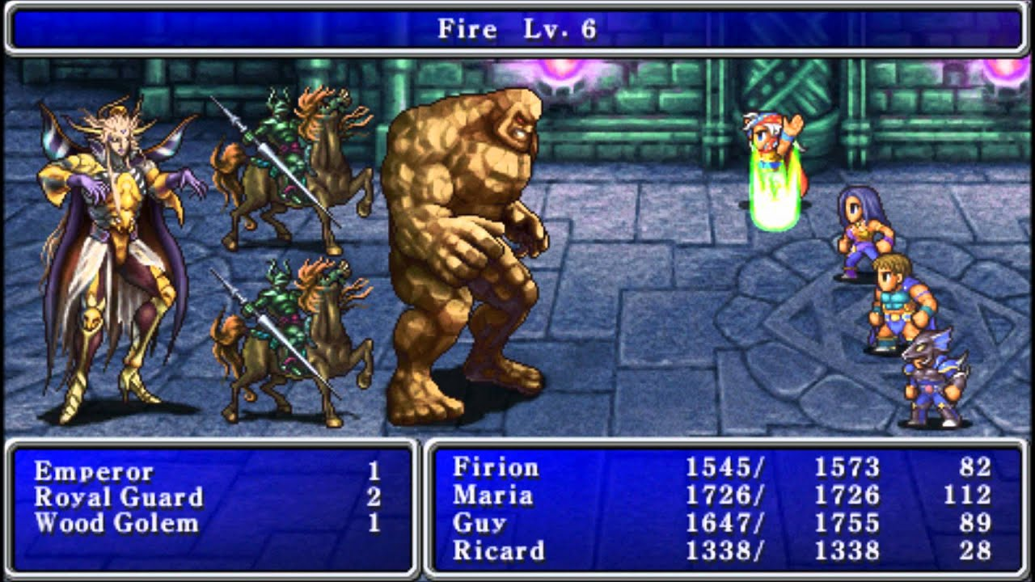
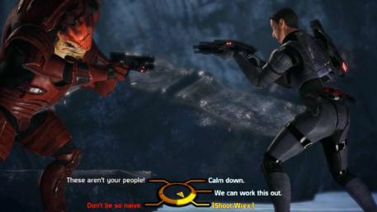
Competitive Analysis
Final Fantasy (combat)
Mass Effect (narrative/conversation)

